Slide 1
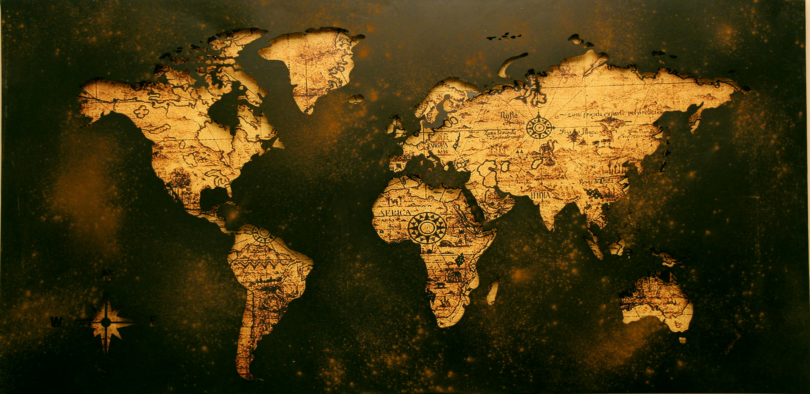
Microstates

Slide 2
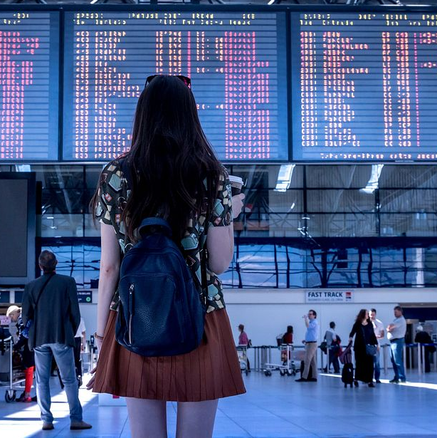
Microstates are small sovereign countries. They often have limited land area and populations.
Despite their size, they play unique roles globally. Microstates can have vibrant economies, rich cultures, and significant political influence. They face unique challenges and opportunities.
In this presentation, we will explore the fascinating world of microstates, their characteristics, and their impact on the global stage. Let's dive in and discover the intriguing aspects of these small but mighty nations.

Slide 3
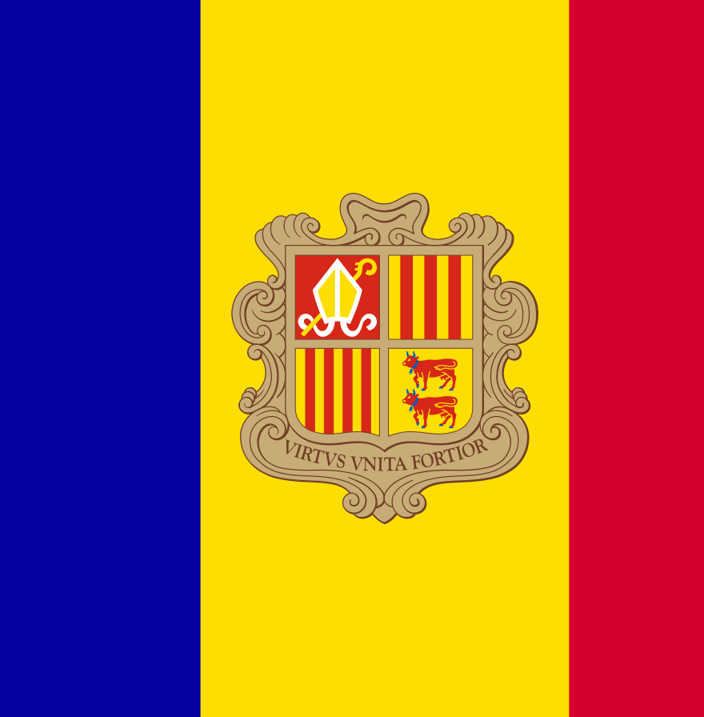
Andorra
Nestled in the Pyrenees between France and Spain, Andorra is a co-principality governed jointly by the President of France and the Bishop of Urgell in Spain.
Tourism, particularly for skiing and its duty-free status, drives its economy. The country's picturesque landscapes and high-altitude climate make it an ideal destination for winter sports enthusiasts and nature lovers alike.
With a land area of just 468 square kilometers, Andorra is the sixteenth smallest country in the world by land area, yet it boasts an impressive array of mountain vistas, ancient churches, and quaint villages.

Slide 4
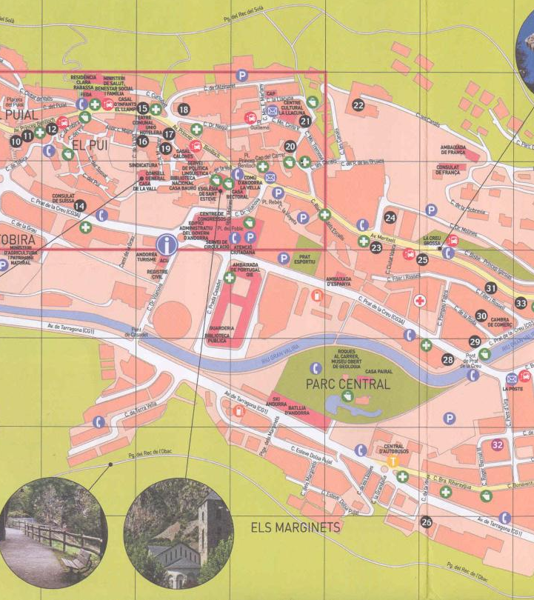
The capital, Andorra la Vella, is renowned for its vibrant shopping scene due to the absence of sales taxes, attracting visitors from across Europe keen on luxury goods, electronics, and alcohol at lower prices.
Cultural heritage in Andorra is rich with Romanesque architecture visible in structures like the Santa Coloma Church, dating back to the 9th century.

Slide 5
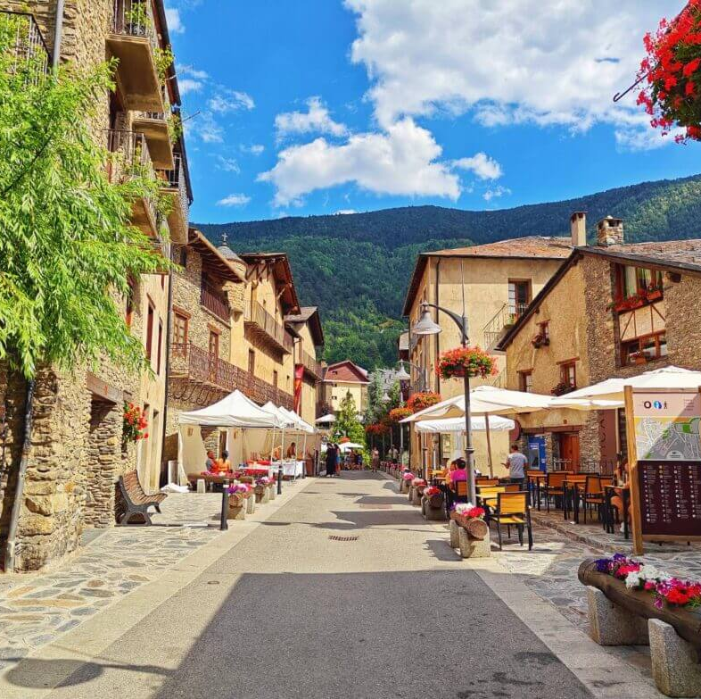
Despite its small size, Andorra maintains a well-developed infrastructure for tourism, with numerous ski resorts, hiking trails, and upscale hotels.
The government's efforts to diversify the economy include banking, retail, and the creation of a burgeoning tech industry.
As a result, Andorra not only offers scenic beauty and recreational activities but also a growing business sector, making it a unique blend of traditional charm and modern convenience.

Slide 6
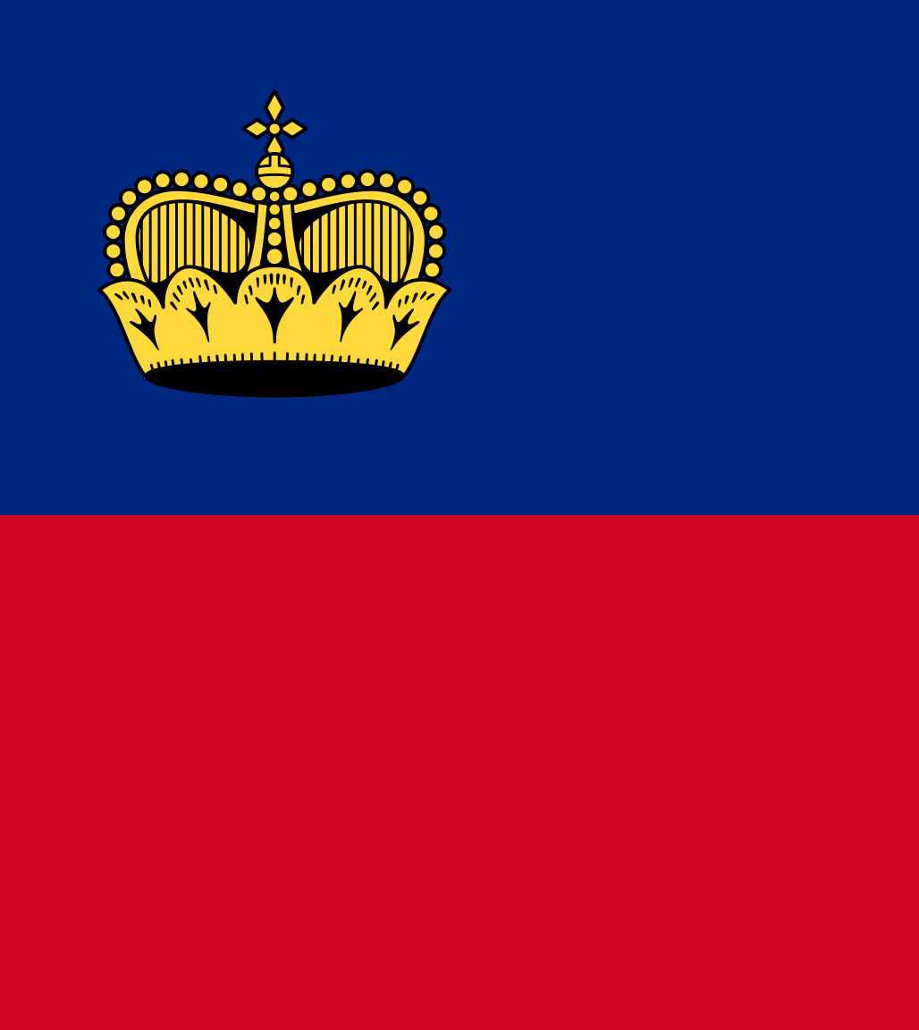
Liechtenstein
Located between Switzerland and Austria, Liechtenstein is a constitutional monarchy with strong economic ties to its neighbors. It's known for its financial services sector.
Covering just 160 square kilometers, Liechtenstein is one of the world's smallest yet wealthiest nations, boasting a high standard of living and a robust economy.
The principality is nestled in the Alps, offering picturesque landscapes and a blend of natural beauty and historical charm.

Slide 7
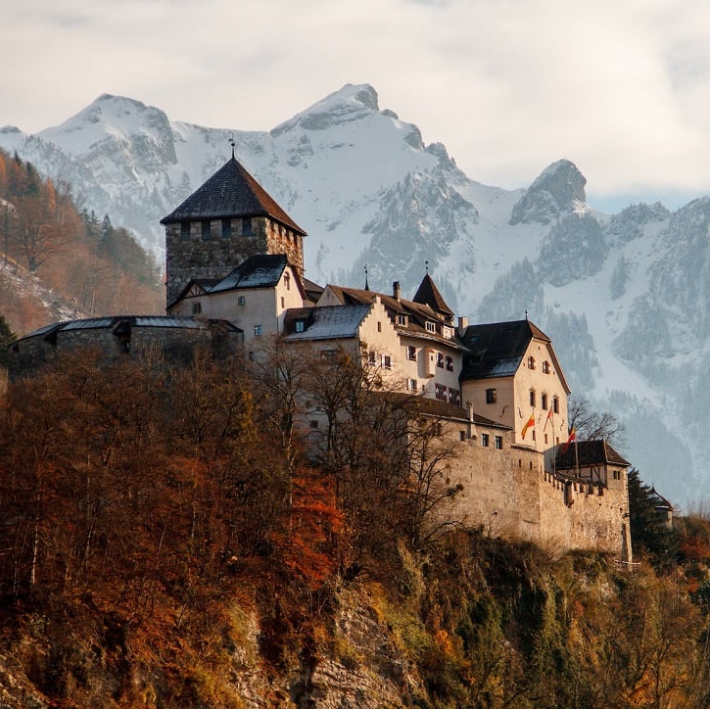
Vaduz, the capital city, is the political and cultural heart of the country. The Vaduz Castle, perched on a hilltop, serves as the residence of the princely family and a symbol of the nation's enduring heritage. The city is also home to the Liechtenstein National Museum, the Kunstmuseum Liechtenstein (an art museum), and a vibrant downtown area with shops and cafes.
Liechtenstein's economy thrives on its financial services, including banking and insurance, which attract international clients due to favorable regulations and political stability. Additionally, the country has a well-developed industrial sector, producing precision instruments, pharmaceuticals, and electronics.

Slide 8
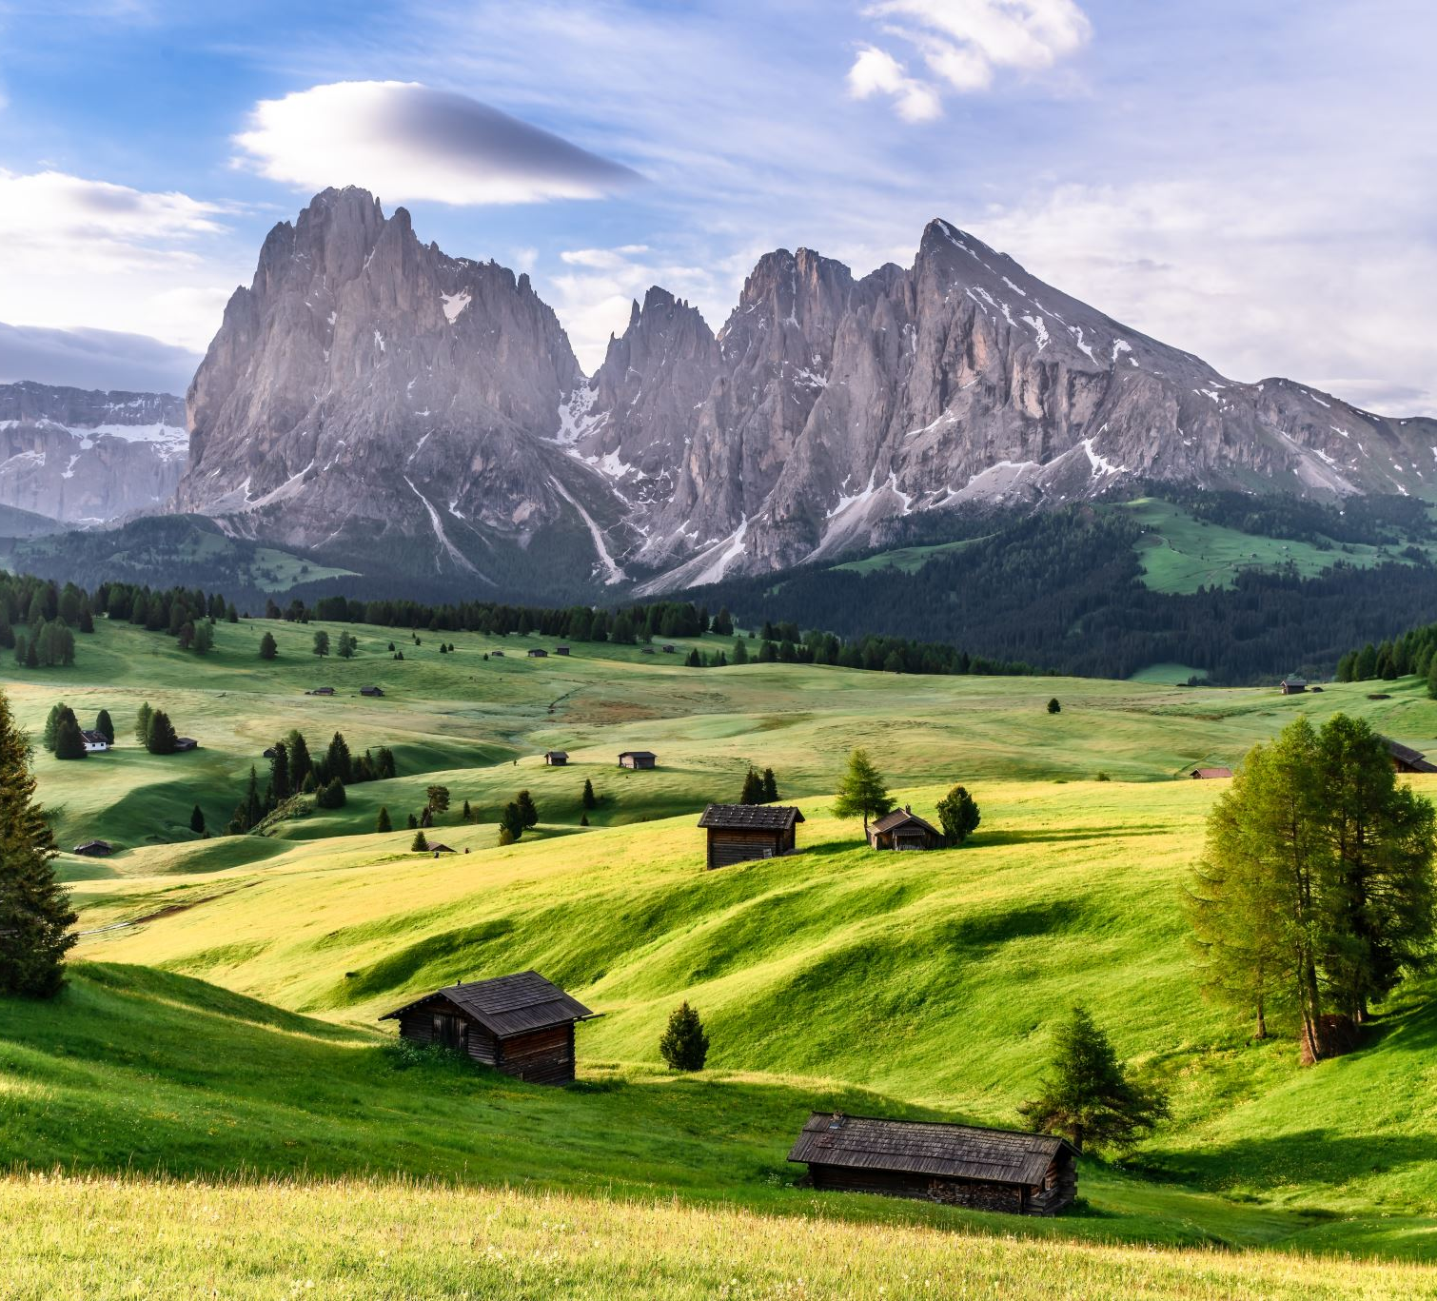
Tourism also plays a vital role, with visitors drawn to its charming villages, hiking trails, and ski resorts. Despite its small size, Liechtenstein maintains a high level of cultural activity with numerous festivals, concerts, and events throughout the year.
This unique blend of economic prowess, cultural richness, and natural beauty makes Liechtenstein a fascinating and prosperous nation.

Slide 9
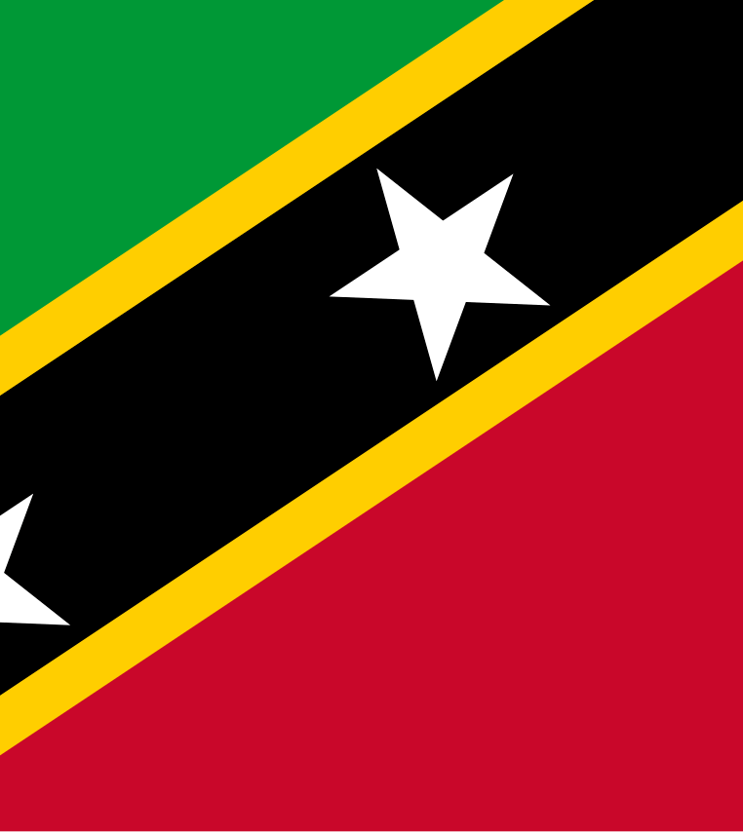
St. Kitts and Nevis
Located in the Caribbean, this two-island nation is the smallest sovereign state in the Western Hemisphere in both area and population. It is known for its tourism and as a site for economic citizenship programs.
Saint Kitts and Nevis, with its lush landscapes and pristine beaches, offers a tropical paradise that attracts visitors from around the globe. The islands' natural beauty is complemented by rich historical sites, such as Brimstone Hill Fortress National Park, a UNESCO World Heritage site, and remnants of colonial-era sugar plantations.

Slide 10
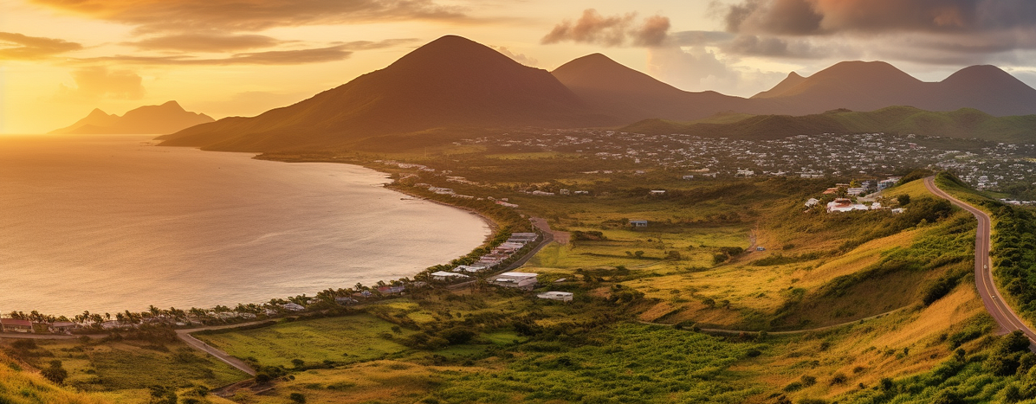
Basseterre, the capital of Saint Kitts, is a bustling port city with a mix of Georgian architecture and vibrant Caribbean culture. Its central market and Independence Square are popular spots for both tourists and locals. Nevis, the smaller of the two islands, is renowned for its tranquility and historical significance, being the birthplace of Alexander Hamilton.

Slide 11
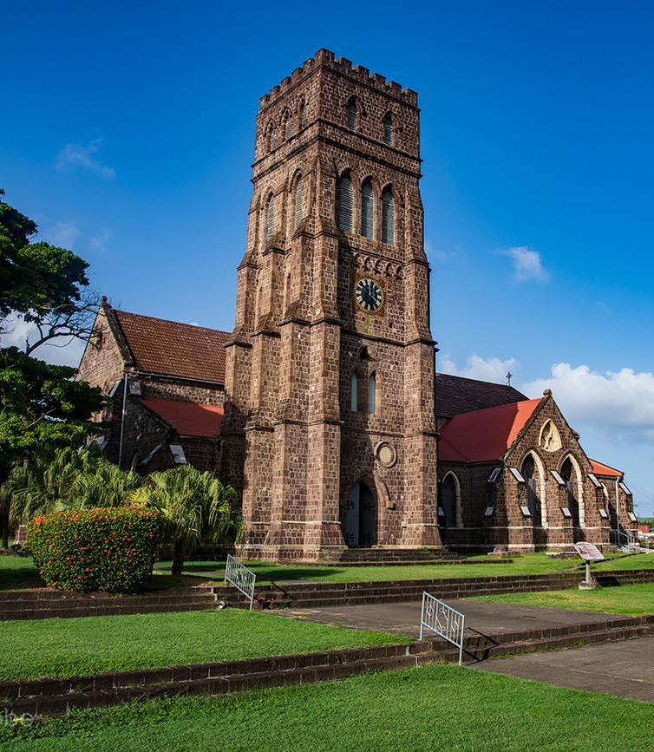
The economy of Saint Kitts and Nevis is heavily reliant on tourism, which is bolstered by the islands' appealing climate, scenic beauty, and a variety of activities such as snorkeling, diving, and hiking. The nation also benefits from its economic citizenship program, which offers citizenship to foreign investors in exchange for substantial contributions to the country's development.
Agriculture, though less dominant than in the past, still plays a role, with a focus on sugarcane, fruits, and vegetables. The government continues to diversify the economy, aiming to attract investment in renewable energy and sustainable development.
With its unique blend of natural charm, historical depth, and economic opportunities, Saint Kitts and Nevis remains a captivating destination for both tourists and investors.

Slide 12
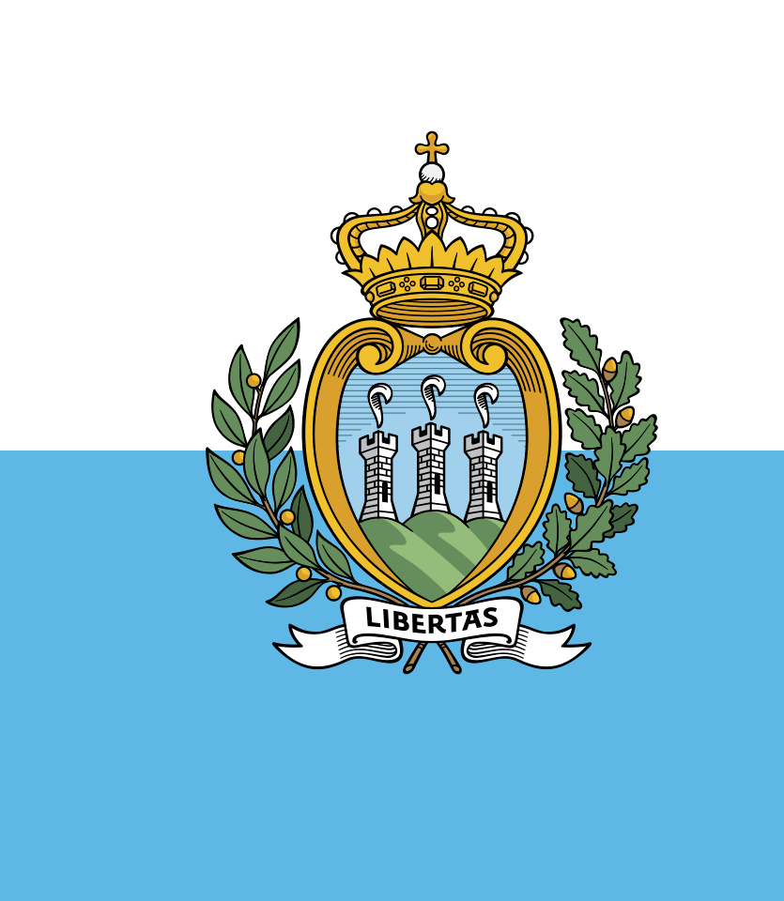
San Marino
Claimed to be the world's oldest republic, San Marino is completely surrounded by Italy. It is renowned for its historic architecture and robust tourist industry.
This tiny enclave, covering just over 61 square kilometers, is perched atop Mount Titano and offers breathtaking views of the surrounding Italian countryside.
San Marino's rich history dates back to 301 AD when it was founded by a stonemason named Marinus. Today, it stands as a testament to centuries of independence and tradition.

Slide 13
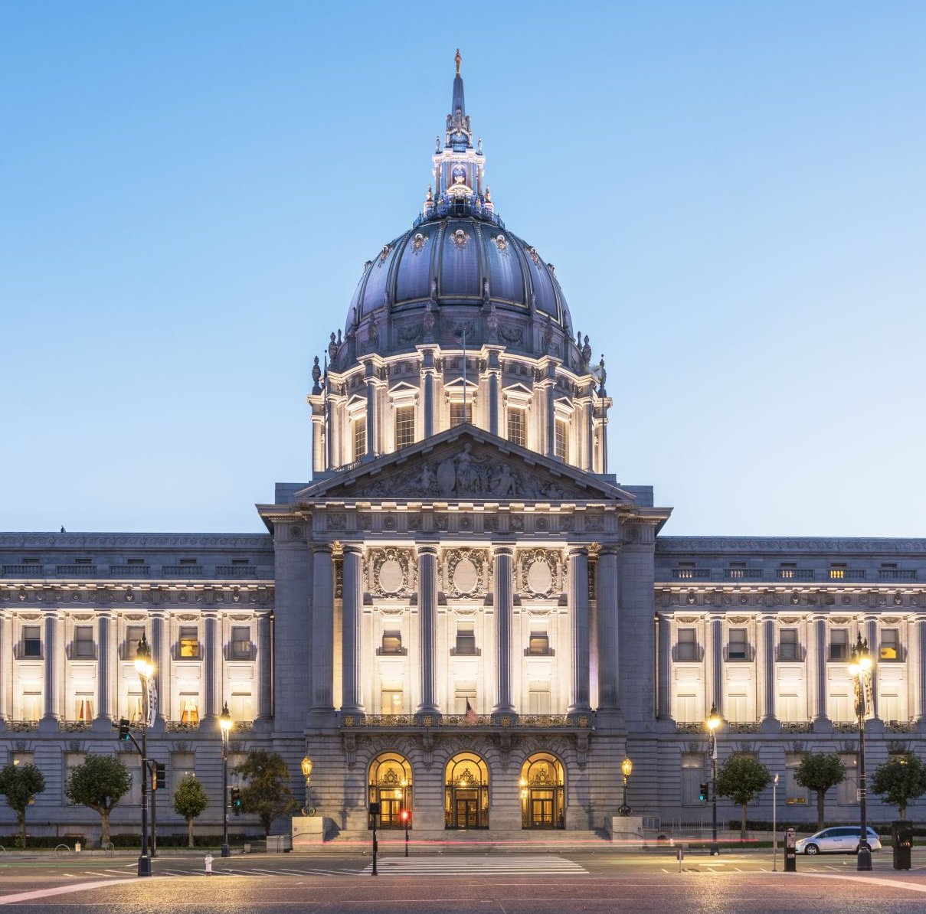
The capital, also named San Marino, is a UNESCO World Heritage site, celebrated for its medieval walled old town and narrow cobblestone streets.
Notable landmarks include the Three Towers of San Marino, each perched on a peak of Mount Titano, and the Basilica di San Marino, which houses relics of the country's patron saint.
The Palazzo Pubblico, or Public Palace, serves as the town hall and the seat of government, reflecting the republic's long-standing political heritage.

Slide 14
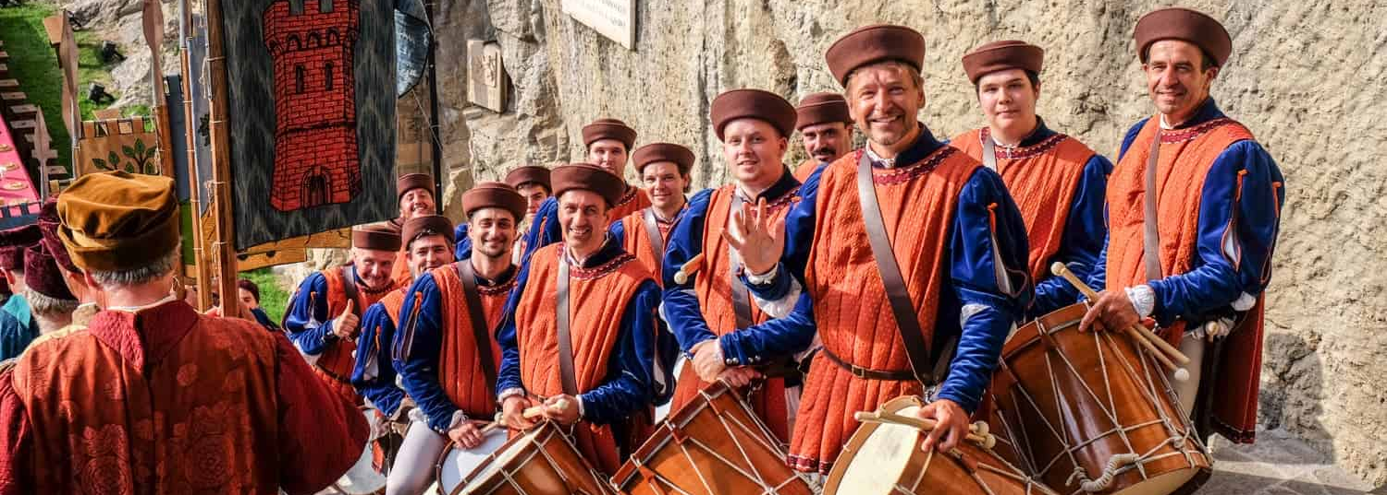
Tourism is a key economic driver, attracting visitors with its historical sites, museums, and duty-free shopping. The annual medieval festival and crossbow tournaments are major attractions, providing a glimpse into the country's storied past.
San Marino also benefits from a stable economy, low unemployment, and a high standard of living, making it a unique blend of historical charm and modern prosperity.

Slide 15

Monaco
Known for its wealth and as a luxurious tourist destination, Monaco is situated on the French Riviera in Western Europe. It has a very small area but a dense population, bolstered by its status as a tax haven.
This independent microstate covers just about 2 square kilometers, making it the second smallest country in the world, yet it is the epitome of glamour and opulence.

Slide 16
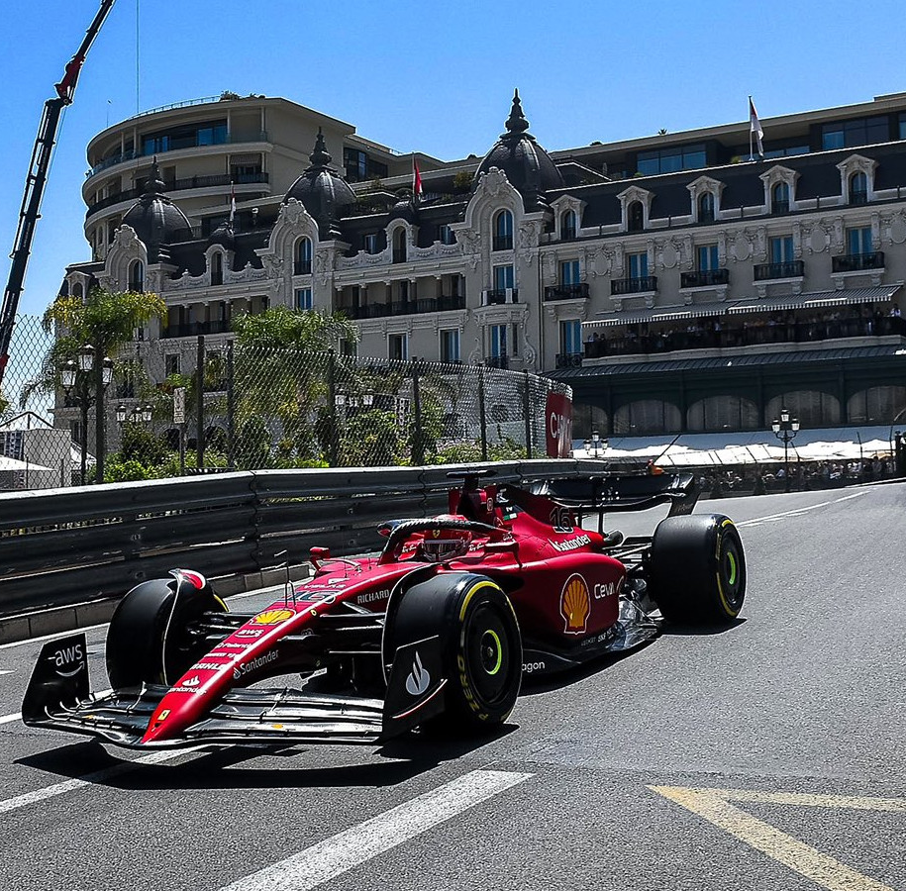
Monaco is renowned for its grandiose events such as the Monaco Grand Prix, one of the most prestigious automobile races in the world, and the Monte Carlo Rally.
Monaco's economy thrives not only on tourism but also on banking and real estate. The principality offers a no-income-tax regime which attracts the wealthy from across the globe, contributing to a high standard of living and a bustling, high-end real estate market. Its Mediterranean coastline, mild climate, and safe environment are additional draws.

Slide 17
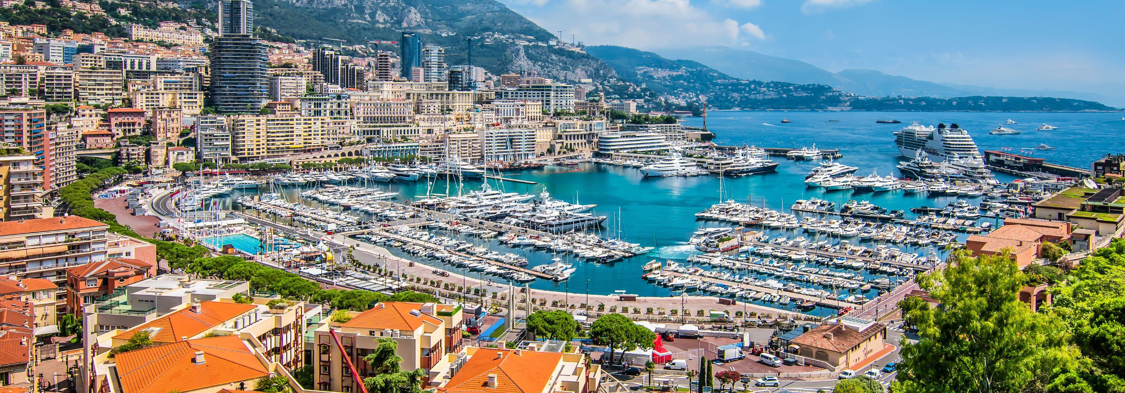
Cultural offerings in Monaco are abundant with museums, opera, ballet, and an annual fireworks competition. The Monte-Carlo Casino, an architectural marvel, adds to its allure, attracting visitors who wish to indulge in world-class gambling.
Despite its diminutive size, Monaco's influence and appeal as a luxury destination are unmatched globally, making it a unique and captivating place to visit or reside.

